Slide 1
Information Systems - What Are They?
Based on Chapter 1 of Bennett, McRobb and Farmer:
Object Oriented Systems Analysis and Design Using UML, (4th Edition), McGraw Hill, 2010.

Slide 2
In This Lecture You Will Learn:
How to define an information system (IS)
Some examples and types of IS
How to use the concepts of systems theory to explain the parts and behaviour of IS
How IS can be useful in managing organizations

Slide 3
Introduction
Information systems (IS) are created by people
They are used in all kinds of organisations
They are important in our everyday lives
All IS must be able to select, store, process and retrieve relevant data
IS do not necessarily depend on digital IT (but most modern ones do)

Slide 4
McGregor On-Line Retail Site
A typical modern IS with:
  Online catalogue display and shopping cart
  Back-office systems store stock details, orders, payment transactions, and more
  Communications link to credit-card processing centre
  Robot warehouse control system
  Delivery scheduling

Slide 5
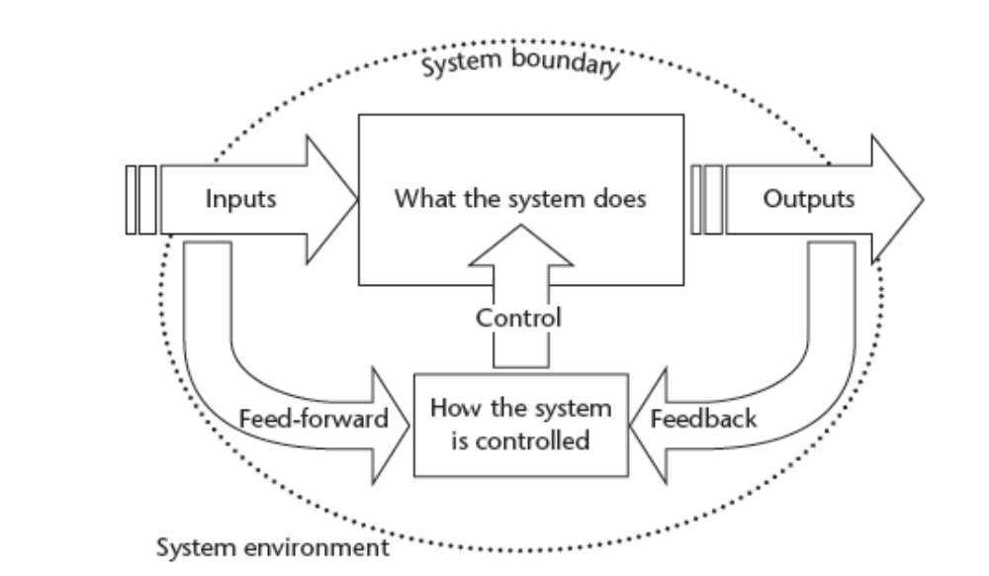
IS are Systems

Slide 6
Characteristics of Systems
Every system has:
  Inputs and outputs
  A purpose (related to transformation)
  A boundary and an environment
  Subsystems and interfaces
  Control using feedback and feed-forward
  Some emergent property
Notes:
Emergent properties, in particular, will almost certainly need further explanation. One good example given by Ed Yourdon (I can’t remember the specific source) was the analyst who turned to a colleague and said “you are certainly more than the sum of your parts – you are an idiot!” The point being that if you look at the parts that make up a person, it would be difficult to find idiocy at any level of analysis other than a holistic view of the whole person.
A useful exercise would be for the class to suggest examples of systems and identify examples of each feature for these.

Slide 7
Elements of an IS
Every IS must have:
  A human activity that needs information
  Some stored data
  An input method for entering data
  Some process that turns the data into information
  An output method for representing information
May also have:
  Subsystems that we can also regard as systems
  Interfaces with other systems

Slide 8
System Transformation
All useful systems transform their inputs into useful outputs
For IS, inputs are typically data or information and outputs are typically also information
This transformation is the whole reason for building and operating the system
It must render the input data useful in some new way
Notes:
That all useful systems produce useful outputs is clearly a tautology, but still an important point.
It is worth spending a little time on getting the class to identify useful transformations for some example systems, and discuss how these are related to wider goals.

Slide 9
Transformation Example
McGregor’s Delivery Scheduling System may have inputs:
  Information about orders, available stock, customer addresses, vehicle capacities…
…And may have outputs:
  Which orders to load on each vehicle, what route the vehicle should follow…
How does this benefit McGregor?
Notes:
To pick up an earlier point, you could ask the class if this system must necessarily be automated. If it is, what are the likely costs and benefits?

Slide 10
Are Systems Real?
Maybe, maybe not!
Systems thinking is useful because it helps to analyse and understand problems
What matters is the understanding you achieve
You can choose to see anything as a system, whether or not it really is one

Slide 11
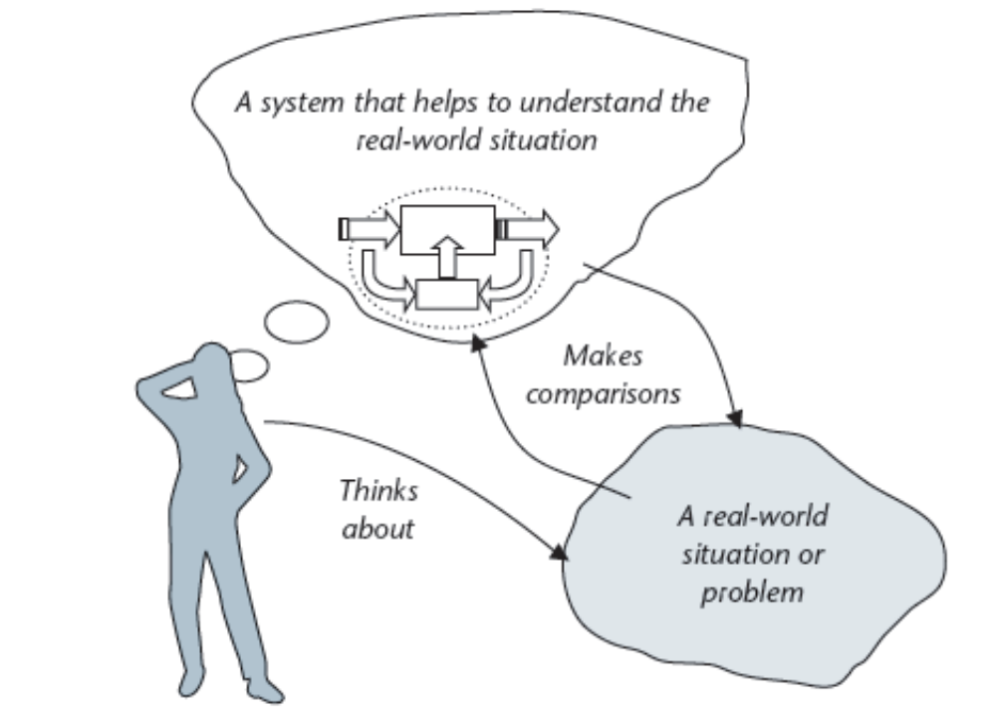
Systems and the Real World

Slide 12
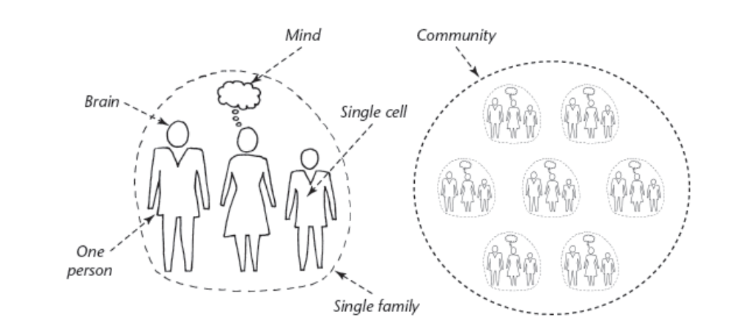
Systems and Subsystems

Slide 13
Types of IS
Information Systems are used to support people’s activities
  Store and retrieve information
  Carry out calculations
  Aid communication
  Control and schedule work
  Other support …. ?

Slide 14
Types of IS (cont’d)
Operational Systems assist or control business operations
  An Accounting System replaces costly and error-prone human clerks
Management Support Systems help managers to decide or to communicate
  A Delivery Scheduling System helps decide how to load and route the delivery trucks
Notes:
This slide could be used to pick up some ethical aspects of automation, especially the possible effects on individuals and communities when jobs are automated. I would not, however, recommend the over-simplification that displacing jobs is always a bad thing. There is little evidence that IT has reduced employment overall. Rather, it has restructured the employment market, replaced some jobs with others, and changed the nature of others (some for better and others for worse).

Slide 15
Types of IS (cont’d)
Real-time Control Systems typically operate physical equipment, often in safety-critical settings
  Some cars have an Engine Management System to control fuel supply and ignition

Slide 16
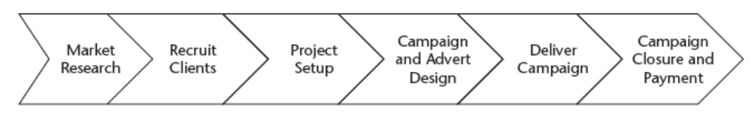
Strategy and Planning for IS
Value Chain analysis is one popular way to analyse an organisation:
Managers can focus on IS that help each of the critical activities along the ‘chain’

Slide 17
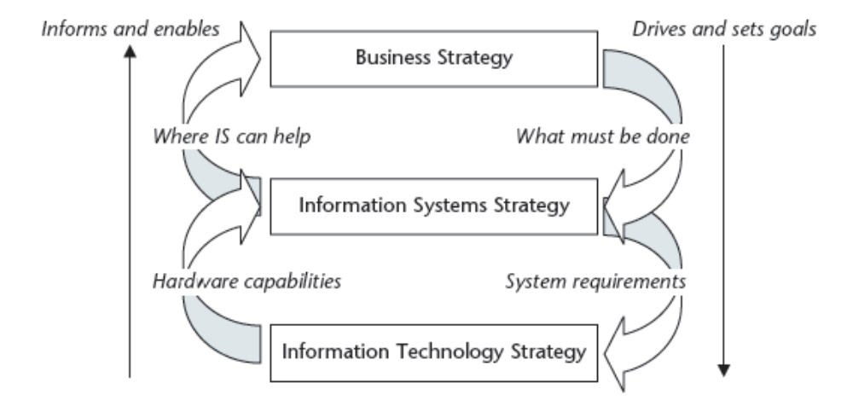
Multiple Strategies for IS and IT

Slide 18
Summary
In this lecture you have learned about:
What an information system is
Some examples and types of IS
Basic concepts of systems theory, and how to apply them to understanding IS
How IS are related to organizations

Slide 19
References
Bennett, McRobb and Farmer (2010)
Checkland and Holwell (1998)
(For further bibliographic details, see Bennett, McRobb and Farmer)

